Slide 1
Partial Solution of 3 x N Chomp boards in the form of [2, H, 2]

Slide 2
Summer research project
Summer 2020
With Dr. B
Combinatorial Games, specifically chomp

Slide 3
What is the Combinatorial Game Chomp?

Slide 4
What makes a CG
Deterministic, no randomness
Perfect Information, nothing is hidden
Two types:
Finite, the game will end, you can't loop
Infinite, the game may not end, you can create loops

Slide 5
Chomp
Played on a board like a chocolate bar where the lower left piece is poisoned
You don’t want to eat the poison, unless you’ve built up a resistance to iocane powder
Alternating turns where you choose a piece and break off all pieces above and to the right of it

Slide 6
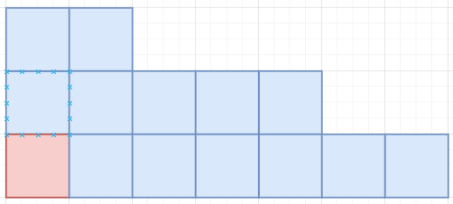
Board Types
Prescriptive: 2 x N, N x N
Pictographic: just a picture
Long form: truncated, lists columns by height
{3, 3, 2, 2, 2, 1, 1}
Short Form: truncated, lists width of groups of column heights
[2, 3, 2]

Slide 7

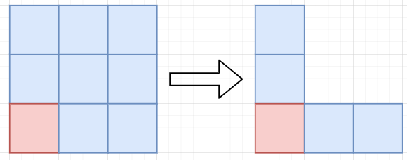
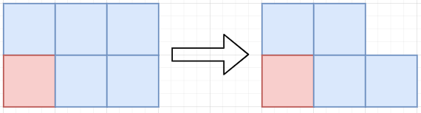
Basic Strategies
What has been solved so far:
1 x N: Go first, leave only poisoned piece
N x N: Go first, make an L, Tweedledee-Tweedledum
2 x N: Go first, take top right, Tweedledee-Tweedledum

Slide 8
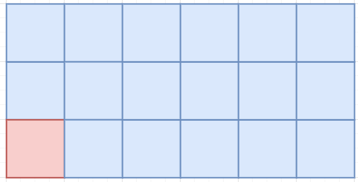
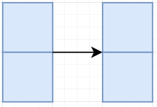
Positions
Winning and losing positions (P vs N)
Every board has a recursively defined Nim Number, but they blew up too fast
Looking at 3 x N boards
Note the arrow can be any number of blocks including zero
I call this an “H-block”
Notes:
On the table, but just keep it in mind, nnum no more than a sentence, maybe mention multiple boards?

Slide 9
What did I do

Slide 10
Data Mining with the Short Form
Wrote a Python script to iterate through all boards from a maximum size to get its position state and those of its children recursively with memoization
Work toward the base case, can exit early
Code on my GitHub for the curious
Noticed a pattern in the Long Form, but it was hard to see, so I made the Short Form
{3, 3, 2, … 2, 1, 1} was always a winning position
[2, H, 2]
Saw a pattern, tried to prove it

Slide 11
Building a Seeded Kindergarten
Generating the first generation of children visually
Generating the first generation of children algorithmically:
Write up the algorithm in math speak

Slide 12
What does that look like for a [2, H, 2]?
As generated by the almighty algorithm
Top:
[1, H + 1, 2]
[0, H + 2, 2]
Middle:
[2, H - K, 2 + K]
[2, H - H, 2 + H]
[1, 0, 2 + H + 1]
[0, 0, 2 + H + 2]
Bottom:
[2, H, 1] s.t. H \geq 1
[2, H, 1] s.t. H = 0
[2, H, 0]
[2, H - K, 0] s.t. (H – K) \geq 2
[2, H - K, 0] s.t. (H – K) = 1
[2, H - K, 0] s.t. (H – K) = 0
[1, 0, 0]
[0]

Slide 13
What does that look like for a [2, H, 2]?
Simplified using the two rules.
Top:
[1, H, 2]
[0, H, 2]
Middle:
[2, H, 2 + K]
[2, 0, 2 + K]
[1, 0, H]
[H]
Bottom:
[2, H, 1]
[2, 0, 1]
[2, H, 0]
[2, H, 0]
[2, 1, 0]
[2, 0, 0]
[1, 0, 0]
[0]

Slide 14
What does that look like for a [2, H, 2]?
Reordered
Group A:
[H]
[1, 0, 0]
Group B:
[1, H, 2]
[0, H, 2]
[2, 0, 0]
Group C:
[1, 0, H]
[2, 0, 1]
[2, 1, 0]
Group D:
[2, H, 2 + K]
[2, H, 1]
[2, H, 0]

Slide 15
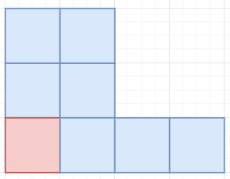
A Funky Dude
Aka [2, H, 2] when H = 0
Just Follow the normal table and treat H as zero
It works fine, but I just wanted to address the base case real fast
Notes:
Addressed in paper, but for presentation

Slide 16
What does that look like for a [2, H, 2]?
Reordered
Group A:
[H]
[1, 0, 0]
Group B:
[1, H, 2]
[0, H, 2]
[2, 0, 0]
Group C:
[1, 0, H]
[2, 0, 1]
[2, 1, 0]
Group D:
[2, H, 2 + K]
[2, H, 1]
[2, H, 0]

Slide 17


Group A: Reduces to 1 x N
[H]
[1, 0, 0]

Slide 18

[0, 0, H + 2 + 2]
[H]; Op left only the bottom row
[1]; Solved 1 x N

Slide 19

[1, 0, 0]
Op broke off all 2’s, all 1’s, and one 3
[1]; Solved 1 x N

Slide 20
What does that look like for a [2, H, 2]?
Reordered
Reduces to 1 x N:
[H]
[1, 0, 0]
Group B:
[1, H, 2]
[0, H, 2]
[2, 0, 0]
Group C:
[1, 0, H]
[2, 0, 1]
[2, 1, 0]
Group D:
[2, H, 2 + K]
[2, H, 1]
[2, H, 0]

Slide 21
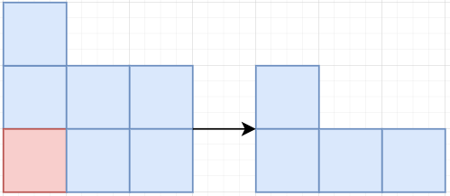
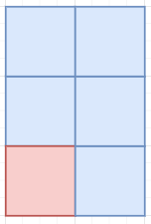
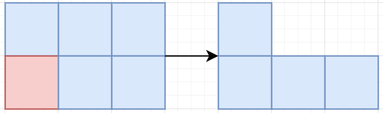
Group B: Reduces to 2 x N
[1, H, 2]
[0, H, 2]
[2, 0, 0]

Slide 22
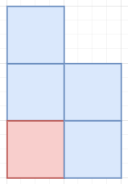
[1, H, 2]
Op removed one top block
[1, 1, 0]; Solved 2xN

Slide 23
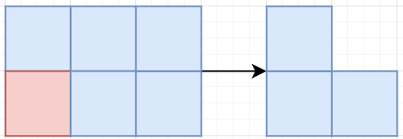
[0, H, 2]
Op cleared top row
[H, 1]; Solved 2 x N

Slide 24
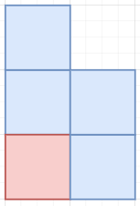
[2, 0, 0]
Op broke off all 2’s and 1’s, or both 1’s when H is zero
[1, 1, 0]; Solved 2 x N (on its side)

Slide 25
What does that look like for a [2, H, 2]?
Reordered
Reduces to 1 x N:
[H]
[1, 0, 0]
Reduces to 2 x N:
[1, H, 2]
[0, H, 2]
[2, 0, 0]
Group C:
[1, 0, H]
[2, 0, 1]
[2, 1, 0]
Group D:
[2, H, 2 + K]
[2, H, 1]
[2, H, 0]

Slide 26
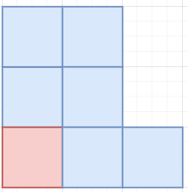
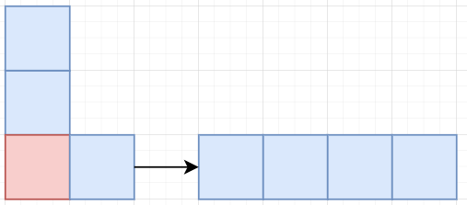
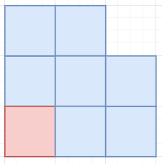
Group C: Reduces to N x N
[2, 0, 1]
[2, 1, 0]
[1, 0, H]

Slide 27
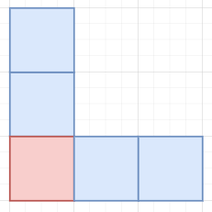
[2, 0, 1]
Op broke of the end piece and H = 0
[1, 0, 2]; Solved N x N

Slide 28
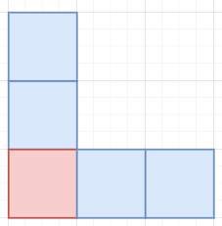
[2, 1, 0]
Op broke off both end pieces and H = 1
[1, 0, 2]; Solved N x N

Slide 29
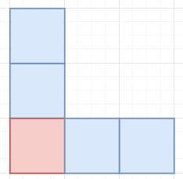
[1, 0, H + 2 + 1]
[1, 0, H + 3]; Op took all the 2’s and one of the 3’s
[1, 0, 2]; Solved N x N

Slide 30
What does that look like for a [2, H, 2]?
Reordered
Reduces to 1 x N:
[H]
[1, 0, 0]
Reduces to 2 x N:
[1, H, 2]
[0, H, 2]
[2, 0, 0]
Reduces to N x N:
[1, 0, H]
[2, 0, 1]
[2, 1, 0]
Group D:
[2, H, 2 + K]
[2, H, 1]
[2, H, 0]

Slide 31
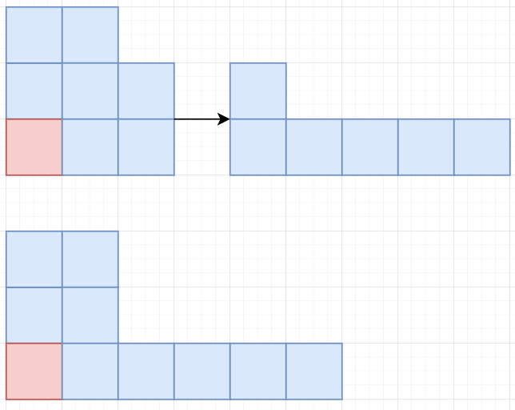
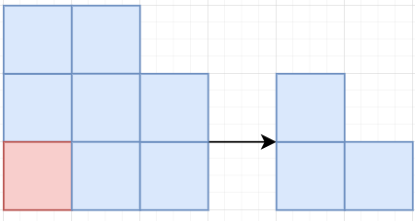
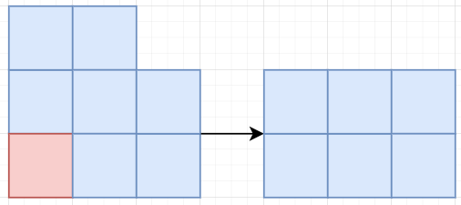
Group D: Maintain [2, H, 2]
[2, H, 2 + K]
[2, H, 1]
[2, H, 0]

Slide 32
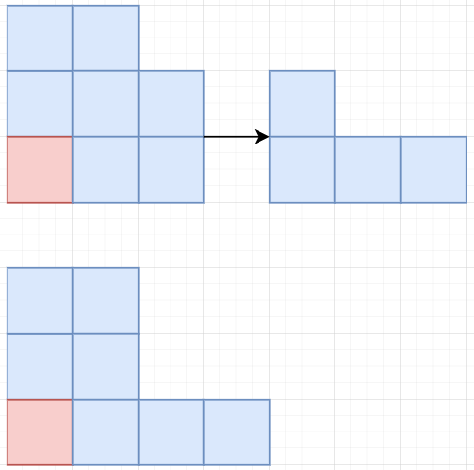
[2, H – K, 2 + K]
Op removed some/all of the 2’s
[2, H – K, 2]; Maintain [2, H, 2] form
There’s that
funky dude

Slide 33
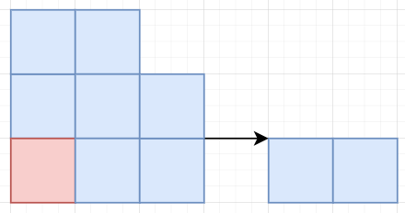
[2, H, 1] s.t. H >= 1
Op broke of the end piece
[2, H - 1, 2]; Maintain [2, H, 2] form

Slide 34
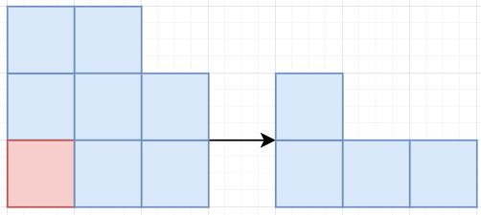
[2, H, 0] s.t. H >= 2
Op broke off both end pieces
[2, H – 2, 2]; Maintain [2, H, 2] form

Slide 35
What does that look like for a [2, H, 2]?
Reordered
Reduces to 1 x N:
[H]
[1, 0, 0]
Reduces to 2 x N:
[1, H, 2]
[0, H, 2]
[2, 0, 0]
Reduces to N x N:
[1, 0, H]
[2, 0, 1]
[2, 1, 0]
Maintain [2, H, 2]:
[2, H, 2 + K]
[2, H, 1]
[2, H, 0]

Slide 36
Summary and Current Problems
As far as I can tell, no one else used the truncated forms before
Partial solution and stable boards
Not very elegant, cases may reduce
Can't reach in one move from $3$ x $N$, but it is stable

